Slide 1

Credit Card Approval Prediction
Batch - 8
Guide: Dr.J.Hyma
Rakesh Naidu | 121810305023
Mani Chandra | 121810305032
Shashidhar | 121810305043
Vishnu | 121810305008

Slide 2
Abstract
The increased credit card defaulters have forced the companies to think carefully before the approval of credit applications. Credit card companies usually use their judgment to determine whether a credit card should be issued to the customer satisfying certain criteria. Some machine learning algorithms have also been used to support the decision.

Slide 3
Abstract
The performance of the built model is compared with the multiple traditional machine learning algorithms: Naive Baye’s , K Nearest Neighbours, Decision Tree, Random Forest, XG Boost . Many other results show that the overall performance of our deep learning model is slightly better than that of the other models.

Slide 4
Abstract
This Project is a machine learning solution to automate the process of credit card approval to an account. The model is trained with multiple attributes and the accuracy is measured with both train and test data.We will use the Credit Approval Dataset which is a collection of credit card applications and the credit approval decisions.

Slide 5
Introduction
The accurate assessment of consumer credit risk is of uttermost importance for lending organizations. Credit scoring is a widely used technique that helps financial institutions evaluates the likelihood for a credit applicant to default on the financial obligation and decide whether to grant credit or not.The precise judgment of the creditworthiness of applicants allows financial institutions to increase the volume of granted credit while minimizing possible losses.

Slide 6
Introduction
The credit industry has experienced a tremendous growth in the past few decades.The increased number of potential applicants impelled the development of sophisticated techniques that automate the credit approval procedure and supervise the financial health of the borrower.

Slide 7
Introduction
The large volume of loan portfolios also imply that modest improvements in scoring accuracy may result in significant savings for financial institutions (West, 2000). The goal of a credit scoring model is to classify credit applicants into two classes: the “good credit” class that is liable to reimburse the financial obligation and the “bad credit” class that should be denied credit due to the high probability of defaulting on the financial obligation.

Slide 8
Introduction
The goal here is to build an end to end automated Machine Learning solution where a user will be able to predict whether a bank customer should be approved for attaining the credit card or not. The user is only need to give the value of feature variables and the model will able to predict the binary outcome (Approve/ Not Approve).

Slide 9
Introduction
The model will be able take care of all intermediate functionalities like cross validation, hyper parameter tuning, algorithm selection etc.
This project shall be delivered in two phases:
Phase 1: All the functionalities with PyPi packages. Phase 2: Integration of UI to all the functionalities.
Note: All the code will be written in python version 3.6

Slide 10
About Dataset
This file concerns credit card applications. All attribute names and values have been changed to meaningless symbols to protect confidentiality of the data.
This dataset is interesting because there is a good mix of attributes -- continuous, nominal with small numbers of values, and nominal with larger numbers of values. There are also a few missing values.
Data Source: UCI, Kaggle

Slide 11
Attribute Information
A1 | b, a | Gender
A2 | continuous | Age
A3 | continuous | Debt
A4 | u, y, l, t | Marital status
A5 | g, p, gg | Bank
A6 | c, d, cc, i, j, k, m, r, q, w, x, e, aa, ff | Education Level
A7 | v, h, bb, j, n, z, dd, ff, o | Ethnicity
A8 | continuous | Years Employed

Slide 12
Attribute Information
A9 | t, f | Prior default
A10 | t, f | Employed
A11 | continuous | Credit score
A12 | t, f | Drivers license
A13 | g, p, s | Citizen
A14 | continuous | Zip Code
A15 | continuous | Income
A16 | +,- (class attribute) | Approved

Slide 13
Literature Review
Credit card has evolved to a great level in banking industry. Each banking system consists of an enormous number of datasets to carry customer's transactions of their credit cards. So, banks would be in need of customer profiling. Customer Profiling in banks cognizes the issuer's decisions about whom to give banking facilities and what credit limit to be provided.

Slide 14
Literature Review
In previous researches, profiling mainly depended on transaction data or demographic data, but in this research, both transaction and demographic data are merged in order to get more accurate results and minimize the possibility of risk occurrence.By using the best techniques, it leads to improvement in accuracy and helps banks to have high profitability through customer satisfaction by focusing on the valuable customer (companies) which are considered as the main engine in the bank's profitability.

Slide 15
Literature Review
This study used k-mean, improved k-mean, fuzzy c-means and neural networks. The used dataset is labeled and for neural network classification creating a new label as a target becomes the main aspect of this study, which helps to reduce the execution time of clustering process and provide the best results with accuracy.

Slide 16
Problem Identification & Objectives
The proposed project is built end to end. Starting from Data Preprocessing to Deployment. This project includes the features like:
Statistical analysis
Hyper parameter tuning
Best algorithm selection
Deployment in Heroku using flask.

Slide 17
Problem Identification & Objectives
The main objectives of the proposed project are to:
Increase the accuracy
Do Exploratory data analysis
Test the model with different algorithms
Try different model selection criteria
Do Hyperparameter tuning
Deploy the project for easy use

Slide 18
Problem Identification & Objectives
Different technologies or libraries used in the project are:
numpy, pandas
matplotlib, seaborn
scipy, scikit learn
xgboost
html, css
flask, gunicorn

Slide 19
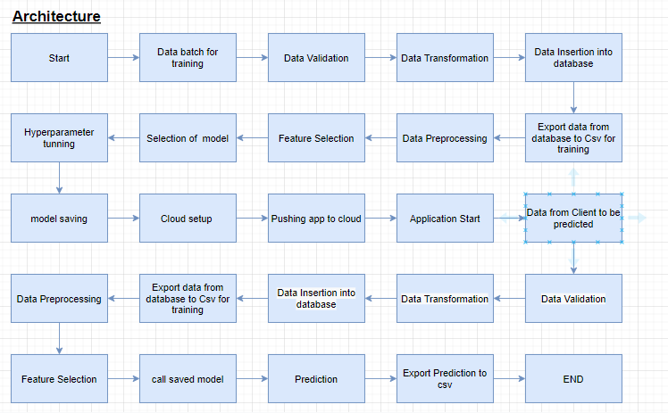
System Methodology

Slide 20
Overview of Technologies
Numpy
NumPy is the fundamental package for scientific computing in Python. It is a Python library that provides a multidimensional array object, various derived objects (such as masked arrays and matrices), and an assortment of routines for fast operations on arrays, including mathematical, logical, shape manipulation, sorting, selecting, I/O, discrete Fourier transforms, basic linear algebra, basic statistical operations, random simulation and much more.

Slide 21
Overview of Technologies
Pandas
Pandas is an open source Python package that is most widely used for data science/data analysis and machine learning tasks. It is built on top of another package named Numpy, which provides support for multi-dimensional arrays. As one of the most popular data wrangling packages, Pandas works well with many other data science modules inside the Python ecosystem, and is typically included in every Python distribution, from those that come with your operating system to commercial vendor distributions like ActiveState’s ActivePython

Slide 22
Overview of Technologies
Matplotlib
Matplotlib is a cross-platform, data visualization and graphical plotting library for Python and its numerical extension NumPy. As such, it offers a viable open source alternative to MATLAB. Developers can also use matplotlib’s APIs (Application Programming Interfaces) to embed plots in GUI applications.

Slide 23
Overview of Technologies
Seaborn
Seaborn is an open-source Python library built on top of matplotlib. It is used for data visualization and exploratory data analysis. Seaborn works easily with dataframes and the Pandas library. The graphs created can also be customized easily. Below are a few benefits of Data Visualization.

Slide 24
Overview of Technologies
Scipy
SciPy is a scientific computation library that uses NumPy underneath. SciPy stands for Scientific Python. It provides more utility functions for optimization, stats and signal processing. Like NumPy, SciPy is open source so we can use it freely. SciPy was created by NumPy's creator Travis Olliphant.

Slide 25
Overview of Technologies
Scikit learn
Scikit-learn is a library in Python that provides many unsupervised and supervised learning algorithms. It’s built upon some of the technology you might already be familiar with, like NumPy, pandas, and Matplotlib! The functionality that scikit-learn provides include: Regression, including Linear and Logistic Regression Classification, including K-Nearest Neighbors Clustering, including K-Means and K-Means++ Model selection Preprocessing, including Min-Max Normalization

Slide 26
Overview of Technologies
Xgboost
XGBoost is a tree based ensemble machine learning algorithm which is a scalable machine learning system for tree boosting. XGBoost stands for Extreme Gradient Boosting. It uses more accurate approximations to find the best tree model. In prediction problems involving unstructured data (images, text, etc.) artificial neural networks tend to outperform all other algorithms or frameworks. However, when it comes to small-to-medium structured/tabular data, decision tree based algorithms are considered best-in-class right now.

Slide 27
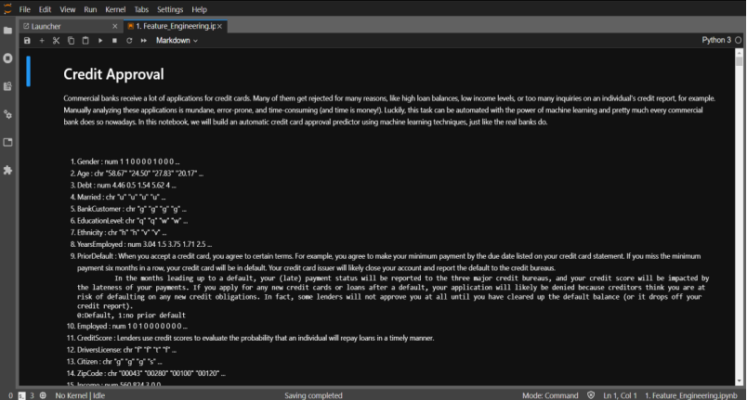
Implementation

Slide 28
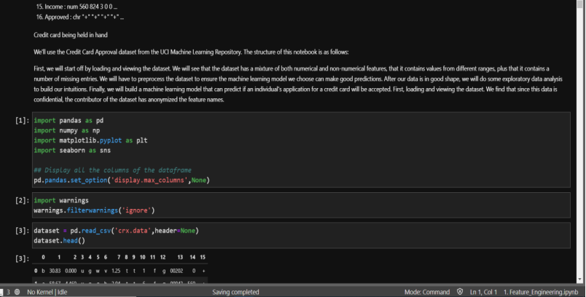
Implementation

Slide 29
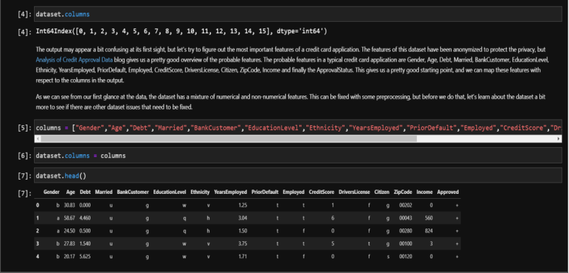
Implementation

Slide 30
Implementation

Slide 31
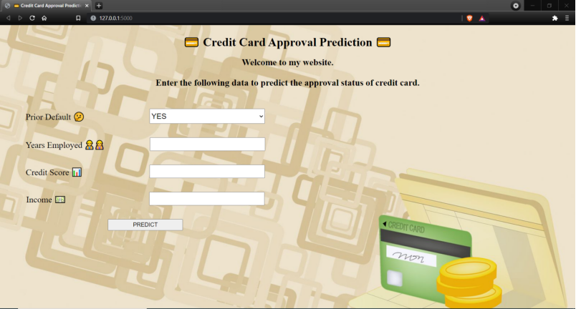
Implementation

Slide 32
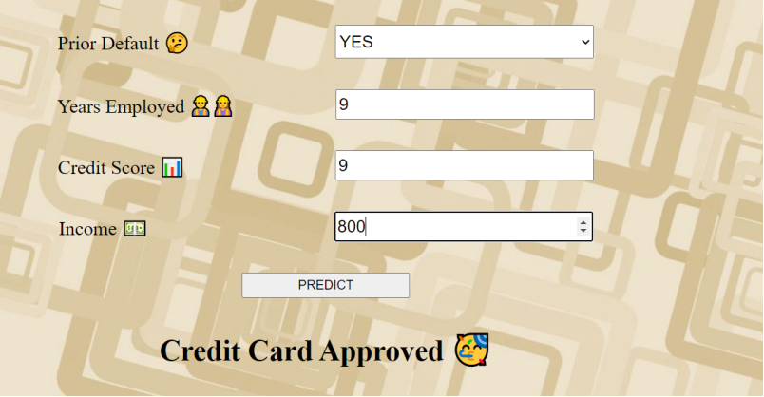
Implementation

Slide 33
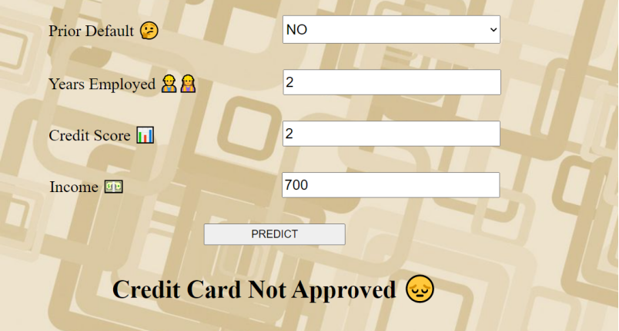
Implementation

Slide 34

Implementation

Slide 35
System requirements
For Model Training | For Model Testing
8 GB RAM | 4 GB RAM
2 GB of Hard Disk Space | 2 GB of Hard Disk Space
Intel Core i5 Processor | Intel Core i5 Processor
Note: These are just Recommended.

Slide 36
Results and Discussions
The accuracy of predicting the credit card is approved and credit card is not approved are almost the same 0.88 and 0.89. The classifier conservatively predicts that the status of credit card approval which will decrease a lost of work for the banks.

Slide 37
Results and Discussions
Accuracy Measure | Value
Specificity | 0.91
Recall | 0.84
Precision | 0.88
F-Measure | 0.86
Accuracy | 0.88

Slide 38
Conclusion and Future Scope
As of now the project has the models like KNN, Naive Bayes, Decision Tree, Random Forest, Xgboost. Neural networks can be used to get a better accuracy model. Neural network models can lead to give accuracies close to 98%.

Slide 39
References
https://www.ijrar.org/papers/IJRAR190B030.pdf
https://www.ijeat.org/wp-content/uploads/papers/v9i4/D7293049420.pdf
https://www.researchgate.net/publication/321002603_Credit_Approval_Analysis_using_R
https://rstudio-pubs-static.s3.amazonaws.com/73039_9946de135c0a49daa7a0a9eda4a67a72.html

Slide 40
Thank You

